Slide 1
Install the ROS program

Slide 2
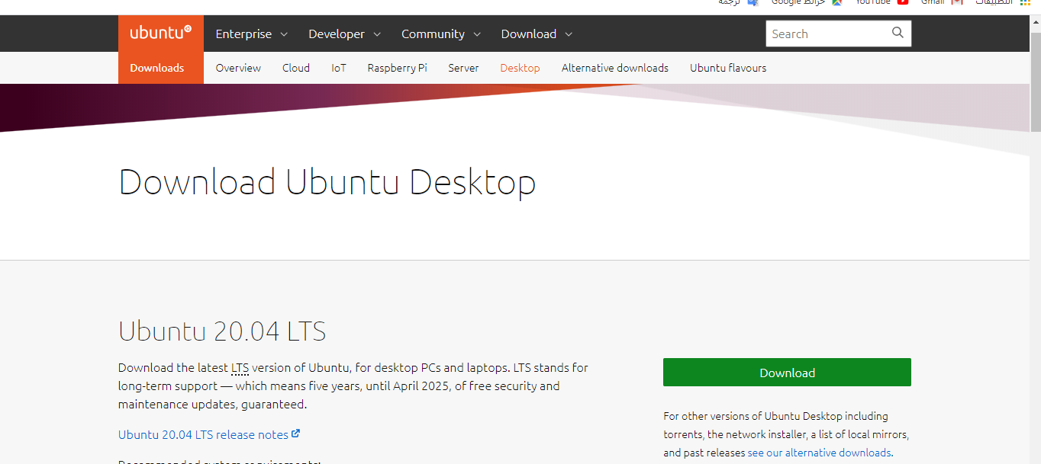
Download Ubuntu 20.04 either on a virtualbox or as platform
Reference
https://ubuntu.com/download/desktop
https://www.virtualbox.org/wiki/Downloads

Slide 3
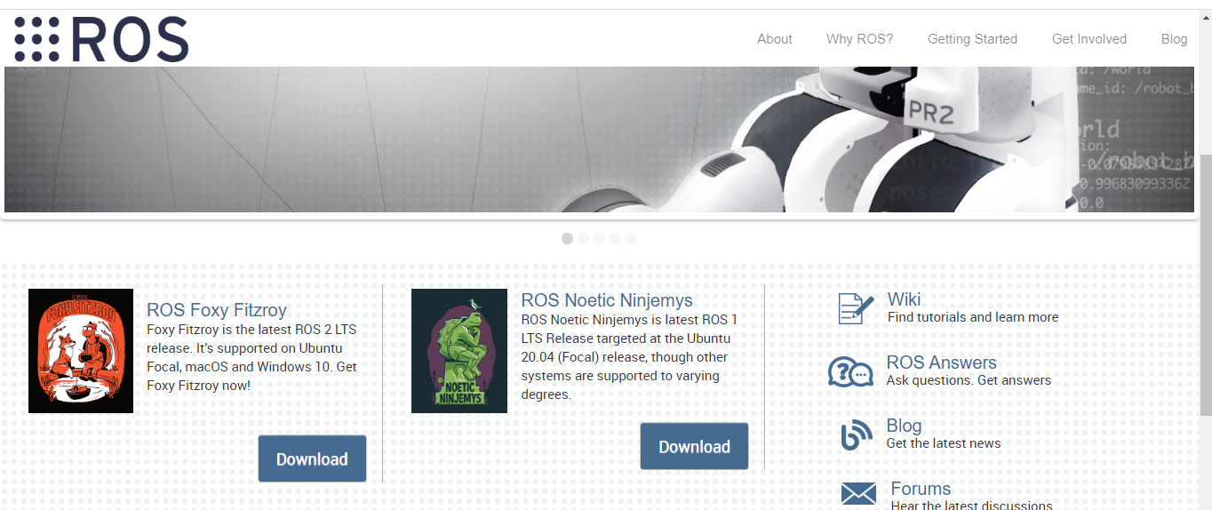
ROS Noetic
Reference
https://www.ros.org/
https://robocademy.com/2020/05/23/getting-started-with-new-ros-noetic-ninjemys/
https://youtu.be/w4ekgzYG0bM

Slide 4
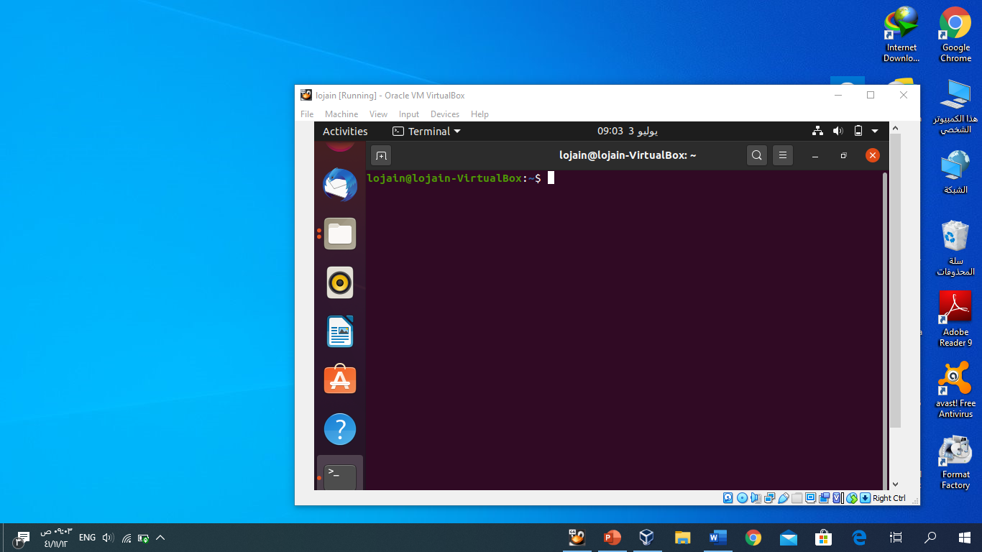
Open the Terminal
Ctrl+Alt+T
To help you more visit this link
https://youtu.be/w4ekgzYG0bM

Slide 5
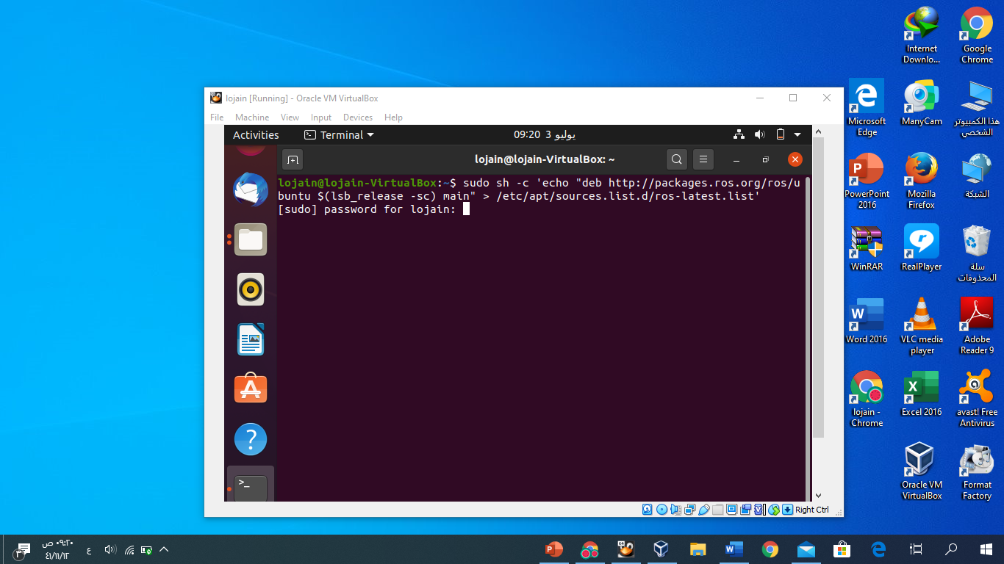
1. First Copy this code sudo sh -c 'echo "deb http://packages.ros.org/ros/ubuntu $(lsb_release -sc) main" > /etc/apt/sources.list.d/ros-latest.list’ and press enter

Slide 6
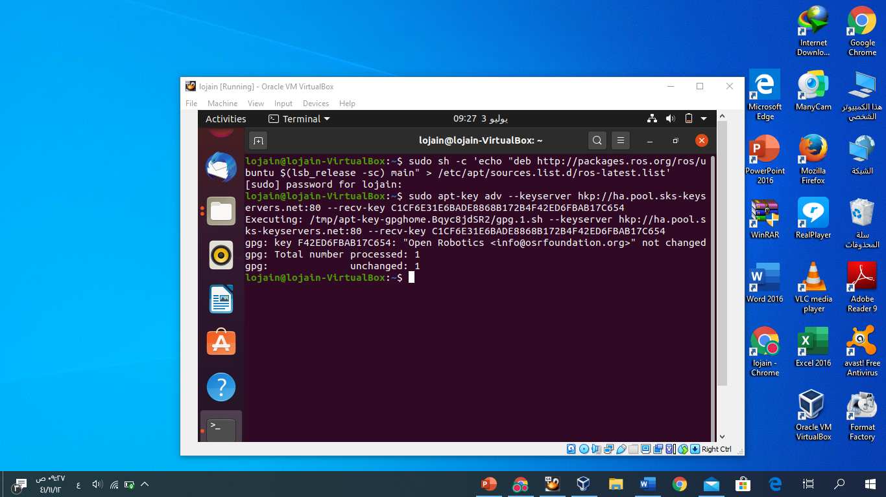
2.put your ubuntu password the password is not shown in the screen just write and press enter* sudo apt-key adv --keyserver hkp://ha.pool.sks-keyservers.net:80 --recv-key C1CF6E31E6BADE8868B172B4F42ED6FBAB17C654

Slide 7
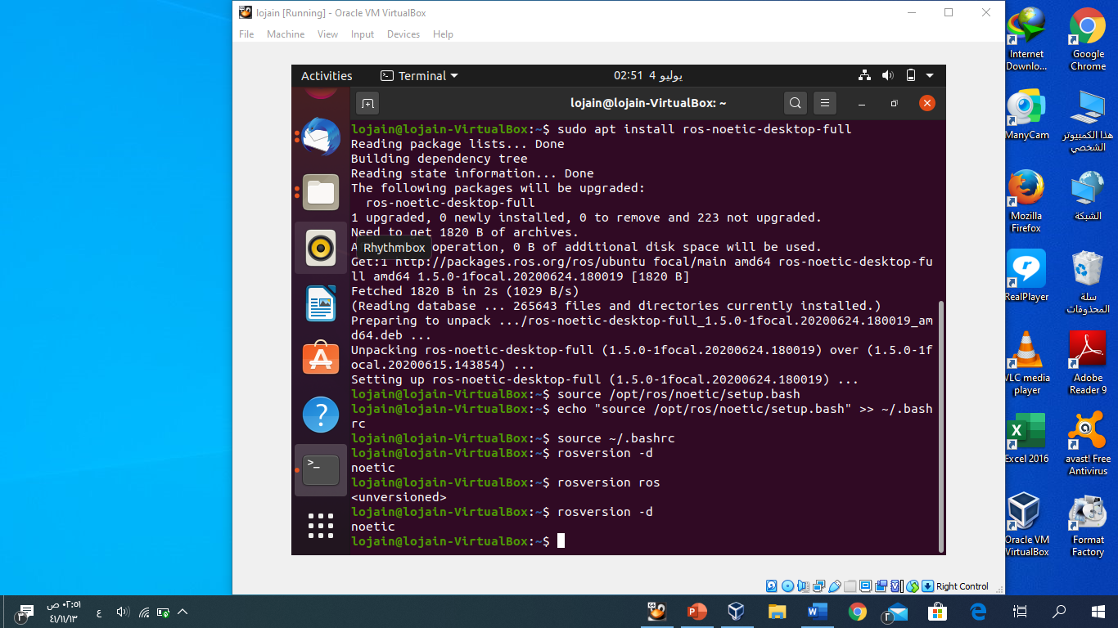
3. Continue with the steps to step 4 look the image and follow the steps

